Slide 1
American Statistical Association Fall Data Challenge
Carl Alexander Bock, WHU
Daniel Hauptmann, WHU
Carl Lackmann, WHU

Slide 2
Definition and development of homelessness in the USA
₁“Homelessness is the condition of people lacking a fixed, regular, adequate night-time residence”
- McKinney-Vento Homeless Assistance Act of 1987
While the population of the USA rose by appr. 8.5% the number of homeless people declined by 14.6% during the same time horizon
Notes:
₁ https://en.wikipedia.org/wiki/Homelessness_in_the_United_States
₂https://www.statista.com/statistics/555795/estimated-number-of-homeless-people-in-the-us/
₃https://www.statista.com/statistics/183457/united-states--resident-population/

Slide 3
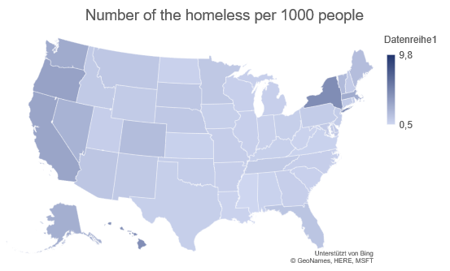
Number of the homeless in the USA per federal state 2018
There are stark regional differences in the share of the homeless
Notes:
2007-2018-PIT-Counts-by-CoC

Slide 4
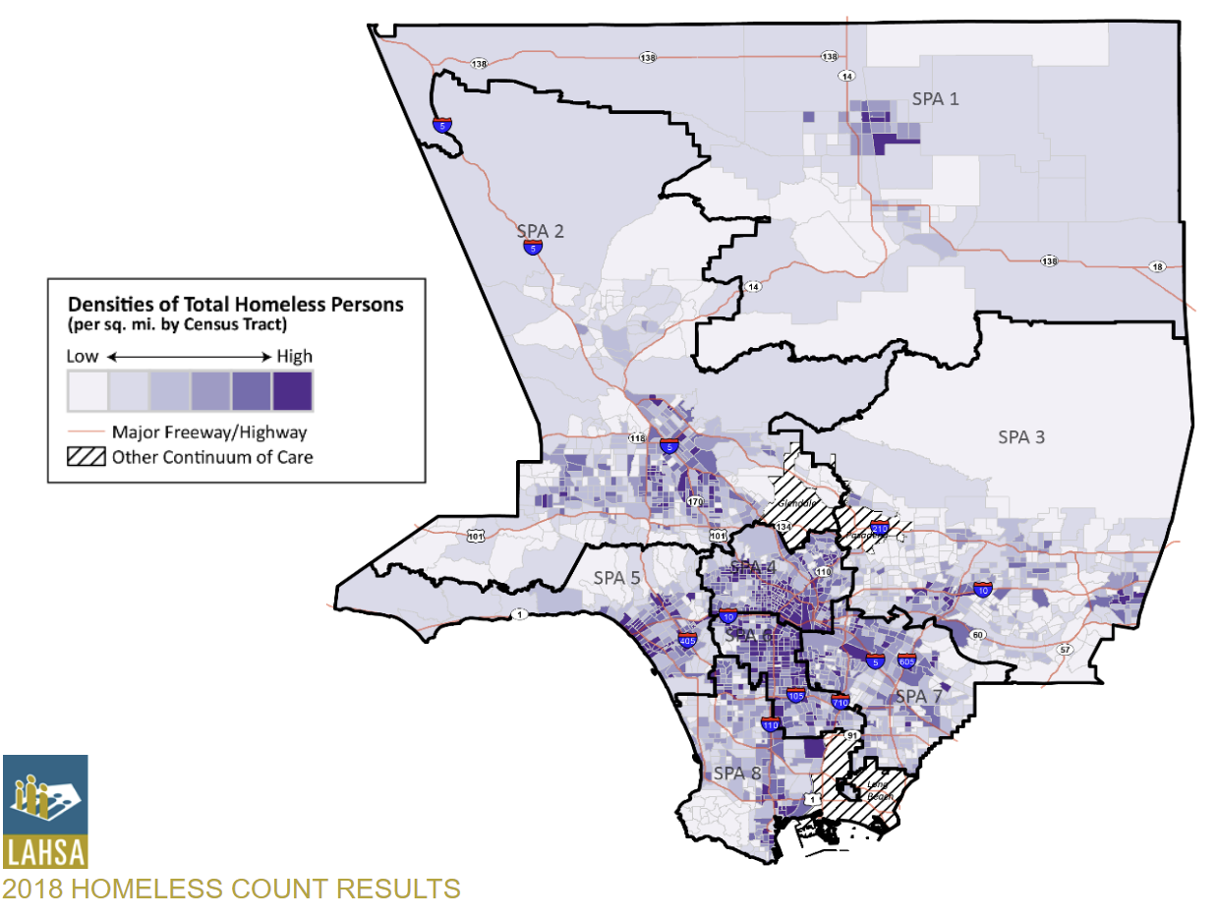
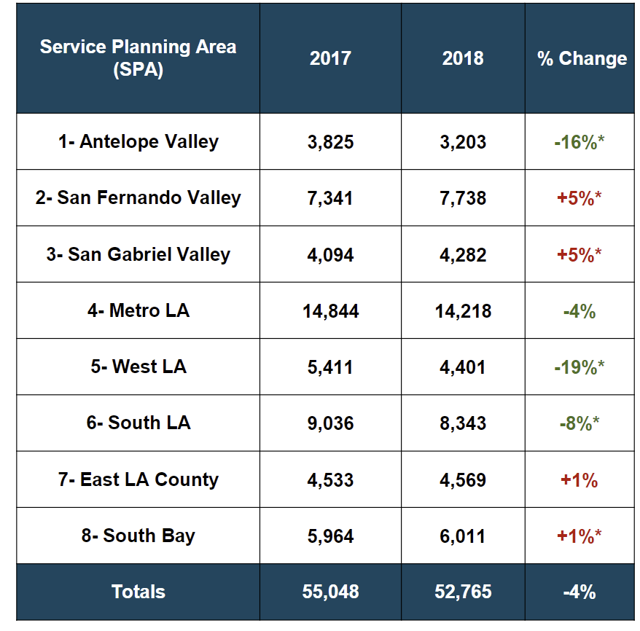
Density of homeless people in Los Angeles divided into SPAs
Notes:
https://www.lahsa.org/documents?id=2059-2018-greater-los-angeles-homeless-count-presentation.pdf

Slide 5
Our statistical approach
Approach
We analysed different independent variables to assess their impact on homelessness
Veteran population (Of 1000 people, how many are veterans?)
Addiction rate (Of 1000 people, how many are addicted to illicit drugs?)
Undocumented Immigrants (Of 1000 people, how many are undocumented immigrants?)
Poverty rate (Of 1000 people, how many are under the poverty level?)
We used Data from the US Department of Veteran Affairs, Pew research, and the US Census bureau
As the independent variable, we chose the homelessness rate (Of 1000 people, how are currently experiencing homelessness?), compiled from the provided HUD data and Census population data
$γ\left(Homeless rate\right)=β_{0}+β_{1}∗Addiction rate+β_{2}∗Undocumented Immigrant rate+β_{3}∗Poverty rate+β_{´4}∗Veteran population+u$
Limitations
The „Continuums of Care“ offered by the dataset suffer from one big limitation – there is no clear availability data that links the geographic boundaries of CoC‘s with associated counties. This would enable us to compare homelessness to publically available county-level data
This forced us to only examine state-wide data, which discounts the large heterogeneity within states – especially along the urban-rural divide
We will go into the significance of our results in the following slides
Notes:
https://www.va.gov/vetdata/veteran_population.asp
https://www.pewresearch.org/hispanic/interactives/u-s-unauthorized-immigrants-by-state/

Slide 6
Our statistical approach
Our Model Approach
$γ\left(Homeless rate\right)=β_{0}+β_{1}∗Addiction rate+β_{2}∗Undocumented Immigrant rate+β_{3}∗Poverty rate+β_{´4}∗Veteran population+u$
We find that only the addiction rate and the rate of undocumented immigrants have a statistically significant impact on the homeless rate in each state (at least 90% confidence)
 | Estimate | Std. Error | t value | Pr(>|t|)
(Intercept) | 0.032 | 1.207 | 0.026 | 0.979
Addiction_Rate | 0.016 | 0.005 | 3.289 | 0.002
UndocImmigrants_Rate | 0.019 | 0.009 | 2.006 | 0.052
Poverty_Rate | -0.004 | 0.004 | -0.843 | 0.404
Vet_Rate | -0.001 | 0.012 | -0.077 | 0.939
99%-Confidence
90%-Confidence

Slide 7
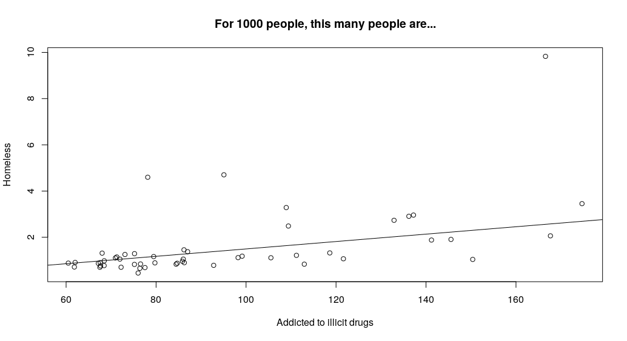
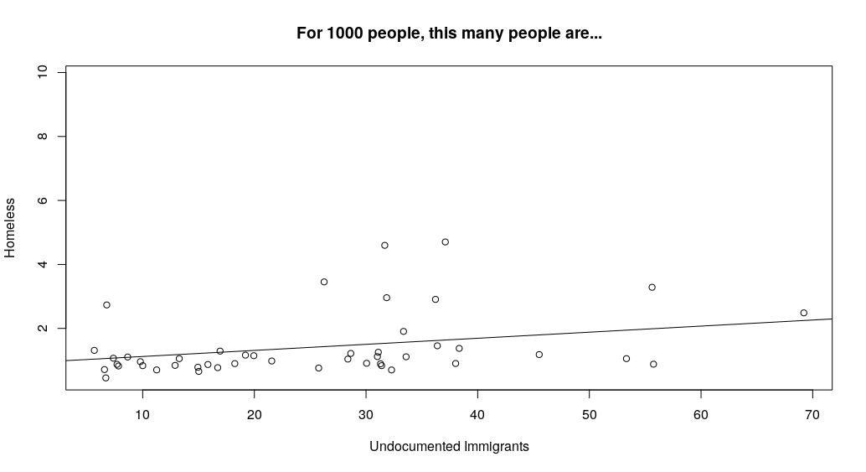
How do drug addiction and recent immigration affect homeless populations?
$$Intercept:{\hat{β}}_{0}+{\hat{β}}_{2}∗\overline{Undoc. Immigrants}+{\hat{β}}_{3}∗\overline{Poverty rate}+{\hat{β}}_{4}∗\overline{Veteran rate}$$
$$= −0.104$$
$$Intercept:{\hat{β}}_{0}+{\hat{β}}_{1}∗\overline{Addiction rate}+{\hat{β}}_{3}∗\overline{Poverty rate}+{\hat{β}}_{4}∗\overline{Veteran rate}$$
$$=0.933$$
$$Slope:{\hat{β}}_{1}=1.6\%$$
$$Slope:{\hat{β}}_{2}=1.9\%$$
→ For every 1000 further people addicted to illicit drugs, we estimate 16 further homeless people
→ For every 1000 immigrants properly integrated into the community, we estimate 19 less homeless people

Slide 8
Conclusion: The three measurements Los Angeles has to take
Firstly we propose a program to integrate undocumented immigrants, as they represent the variable with the highest correlation of $β2=0.019$. 925,000 unauthorized immigrant are living In Los Angeles as of 2016. Measurements to reduce this number, and hence the homeless rate, include the integration with job programs and lowering immigration hurdles.
Secondly we would start drug abuse prevention programs, as drug addiction has the second highest correlation with $β1=0.016$. Measurements we would expect to have an impact on reducing this number are prevention programs, professional education, and job training programs.
Apart from our focus on the two risk groups we identified, namely drug addicts and undocumented immigrants, we want to reduce the existing homeless population. More sheltering needs to be built, which offer basic facilities ensuring certain hygiene standards. Those longer-term shelters have the purpose of getting homeless people back into real jobs and real houses. Control groups should be established in the homeless hot spots of Los Angeles such as the Metro Area and South LA. Permanent housing solutions have proven successful in other states such as Utah.

Slide 9
Outlook: feasibility of using randomized control trials (RCT‘s) in assesing the Impact of prevention measures
In 2019, the Nobel Prize in Economics was awarded to Michael Kremer, Abhijit Banerjee, and Esther Duflo for their experimental approach to alleviating global poverty
In their work, they used randomized control trials to assess the impact multiple measures had on education, hygiene, and other developmental goals
We could imagine using a similar approach to solving homelessness in the USA – especially when confronted with different possible points of action, such as prevention and emergency sheltering
Possible measures for experimental analysis using RCT‘s
New methods of sheltering and care, such as permanent housing
Job-finding programs
Criminal justice reforms
Healthcare vouchers for Drug addicts
Cash Handouts
The next step

Slide 10
Appendix
Sources:
https://www.hudexchange.info/resource/5783/2018-ahar-part-1-pit-estimates-of-homelessness-in-the-us/
https://en.wikipedia.org/wiki/Homelessness_in_the_United_States
https://www.statista.com/statistics/555795/estimated-number-of-homeless-people-in-the-us/
https://www.statista.com/statistics/183457/united-states--resident-population/
https://www.samhsa.gov/data/sites/default/files/cbhsq-reports/NSDUHsaeTotal2017A/NSDUHsaeTotals2017.xlsx
https://www.pewresearch.org/hispanic/interactives/u-s-unauthorized-immigrants-by-state/
https://www.census.gov/quickfacts/US (substitute US by state for state-level information)
https://www.va.gov/vetdata/veteran_population.asp
Our dataset:
Our R-code (multivariate linear regression):

