Slide 1
Police Data Challenge
Catie Bartholomew, Grace Ding, Sophie Mason, Allie Restani
Valley Christian High School
Mrs. Smith
Advanced Data Analysis

Slide 2
Background
Objective
We are hoping to deduce likely times and locations for future crimes in order to help police forces redistribute their patrol in the most effective and efficient way by analyzing crime data from 2016.
We prioritised the following crimes* (see below definition) because we felt that patrol cops had the best chance at preventing or interfering: assault, burglary, dispute, DUI, homicide, injury, prostitution, purse snatching, robbery, threats.
We believe this would give us the most impactful, relevant information regarding the safety of the community.
Before we can run any statistical tests or do any data analysis, we need to have clean data.
There were many duplicates in the data (probably because of the data being reported by multiple officers) and they weren’t proportional. There are more responding officers in murder or violent person crime than there are to a report of vandalism or a DUI.

Slide 3
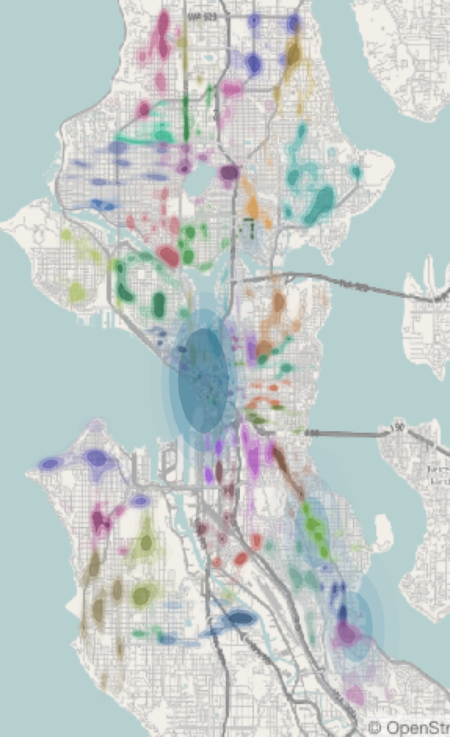
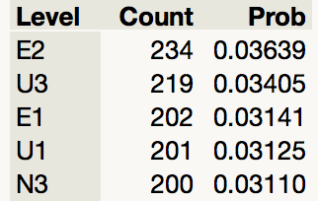
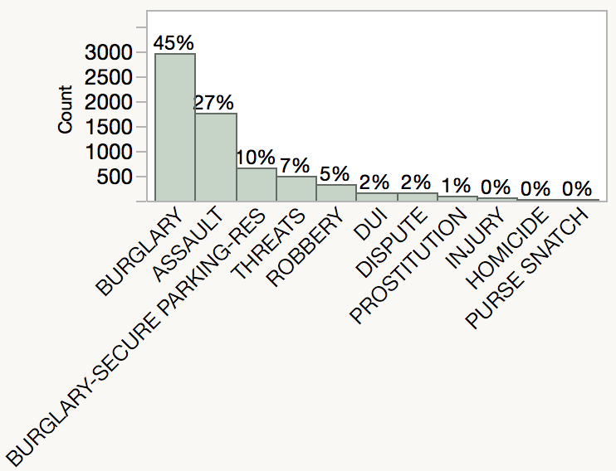
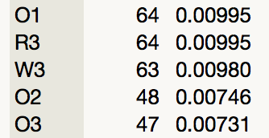
January - March
Top 5 Highest Crime Beats
The red circles on the map signify the beats where the most crime* occurs, and the green circles indicate the beats where the least crime* occurs.
We suggest that the Seattle Police Department pulls some patrol officers from the green areas and redistributes them amongst the red.
This histogram below illustrates the beats where the most to least crime* occurs.
The most popular crime* committed in this quarter was burglary
N3
U3
U1
Lowest 5 Crime Beats
E1
E2
O1
O2
O3
R3
W3

Slide 4
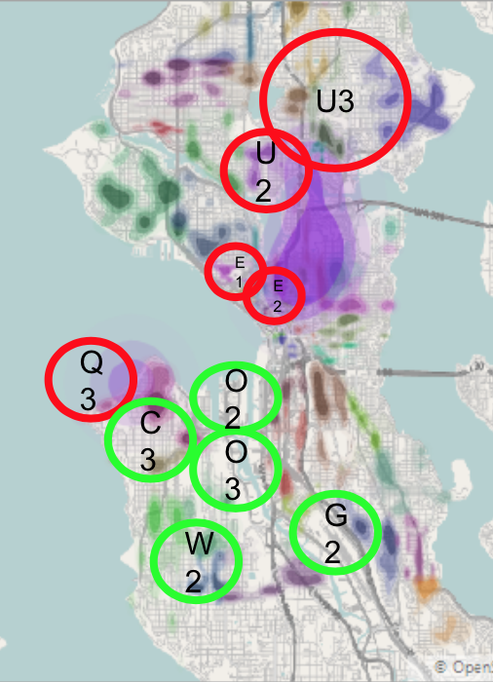
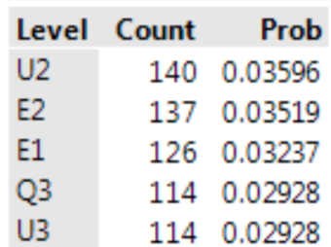
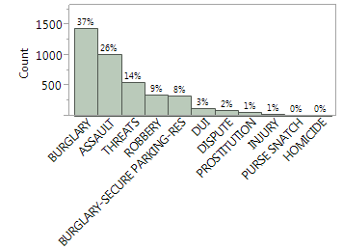
April - June
5 Highest Crime Beats
U3
Some officers should be moved from the green areas to the red areas, where crimes* happen more.
The most common crime* during this period was burglary.
U2
E1
E2
5 Lowest Crime Beats
O2
C3
O3
G2
W2

Slide 5
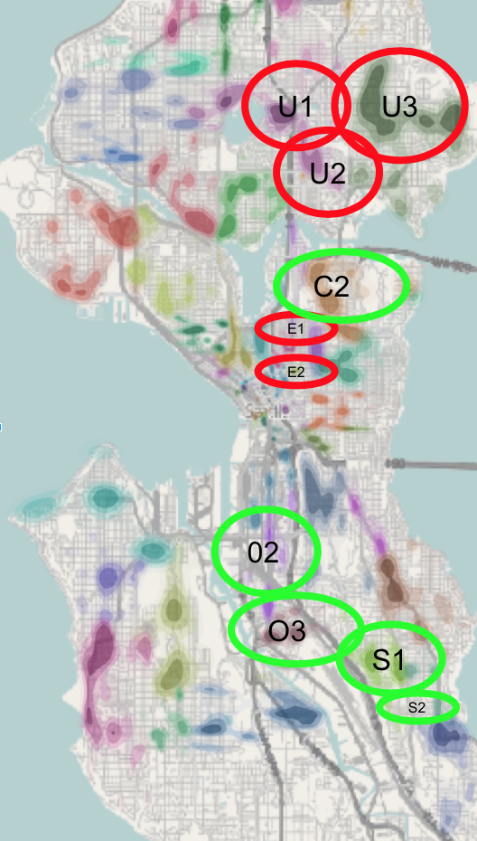
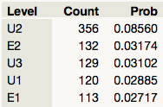
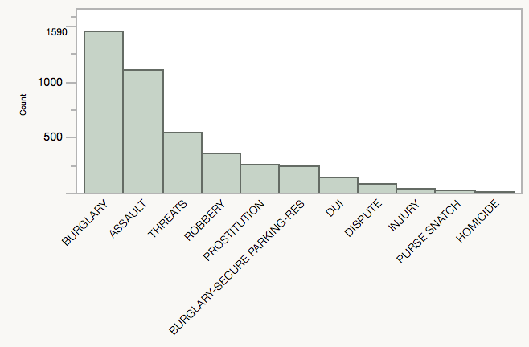
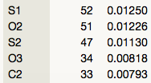
July - September
5 Highest Crime Beats
U1
U3
Officers should be moved from the green areas to the red areas, where crimes* happen more.
The most common crime* during this period was burglary.
U2
C2
E1
5 Lowest Crime Beats
E2
02
O3
S1

Slide 6
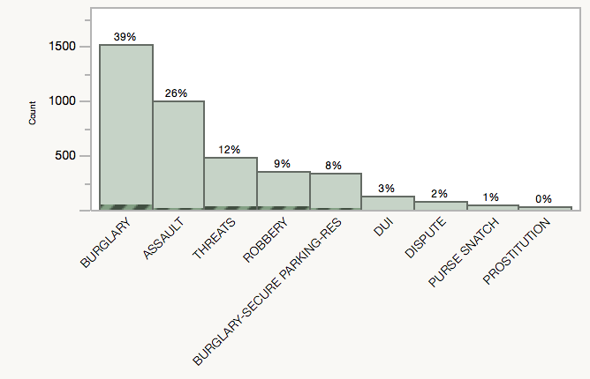
October - December
U1
5 Highest Crime Beats
Officers should be moved from the green areas to the red areas, where crimes* happen more.
The most common crime* during this period was burglary.
U2
M2
5 Lowest Crime Beats
D1
E2
O2
W3
O3
R3
S2

Slide 7
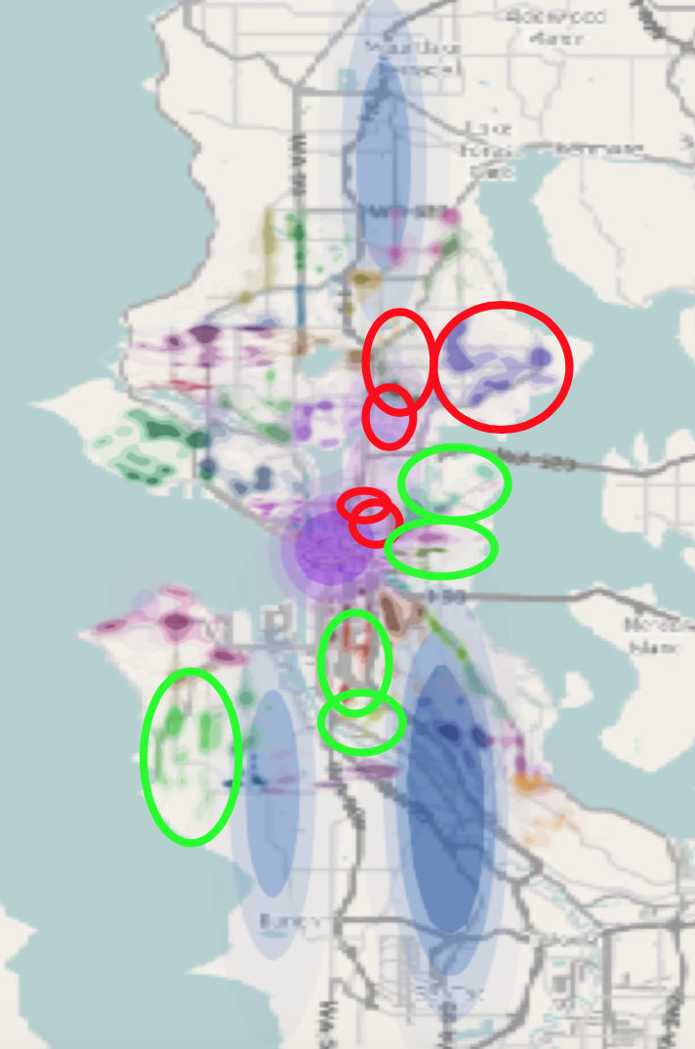
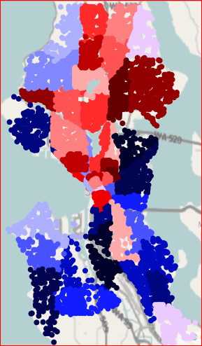
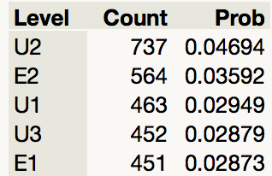
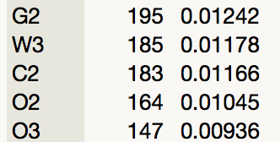
January - December
Highest/Lowest Beats
Crime Map
We analyzed how the 5 highest beats changed from quarter to quarter and found that E2 and U2 were consistently topping the charts.
Additionally, O3 was in every quarter’s bottom 5, and it has the lowest overall probability of crime*.
We understand that your personnel is very limited, so we recommend that E2 and U2 receive special attention and significantly more patrol cars (that can be spared) in order to help lessen crime* and make the community a safer place.
5 Highest Crime Beats
5 Lowest Crime Beats
Red: High
Blue: Low

Slide 8
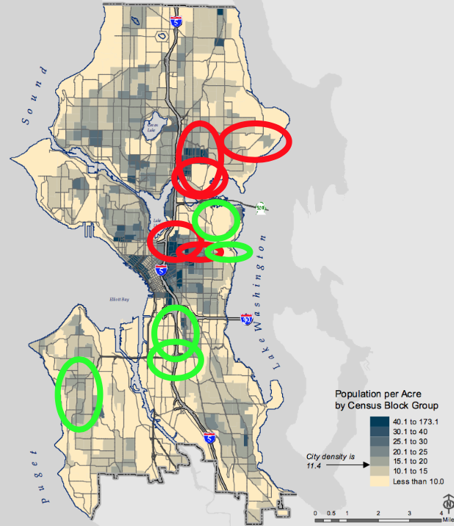
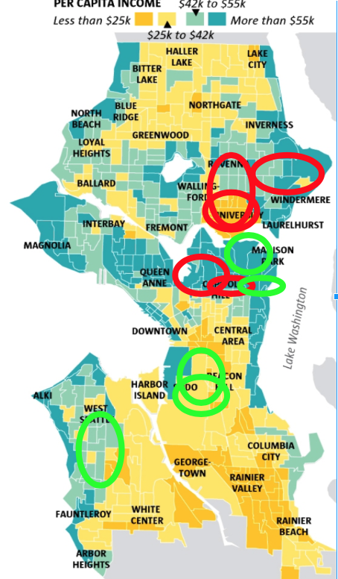
Seattle Population Density
Average Household Income
Unusual Observations
We noticed there is significantly more crime* in the North.
We compared household income and population density to this crime* pattern and found a possible link.
There are significantly more people and significantly more crime* in the North.
Additionally, we noticed that the areas where the most crime* occurs, also have the highest household income.
This might be because the most popular crime* was aggravated/forceful burglary. It’s possible that there are more burgalaries occurring where household income is higher — more things to steal.

Slide 9
Because of our time restrictions, we had to split the time periods into three month quarters. Our recommendations for future studies is to do a weekly analysis of the distribution of crimes per beat because the number of violent crimes is different for different weeks and months. We suggest a relocation of police officers temporarily to beats with higher crime density on a weekly or monthly basis, because the number of crimes* is also different weekly and monthly.
If allotted more time, it would be our goal to generate an algorithm that would predict the most likely time and place of future crimes.

Slide 10
Works Cited
med-over-double-digit-increase-in-violent-crime/
https://www.seattle.gov/police/information-and-data
https://www.policedatainitiative.org/datasets/
https://buildthecity.files.wordpress.com/2011/03/seattle_2010_density.jpg
https://data.seattle.gov
http://seattletimes.wpengine.netdna-cdn.com/fyi-guy/files/2013/12/politicsnw-maps-c.jpg
http://www.seattle.gov/Documents/Departments/OPCD/Demographics/GeographicFilesandMaps/2010CensusProfile.pdf

