Slide 1
Baltimore Crime Data
BETHEL PARK HIGH SCHOOL

Slide 2
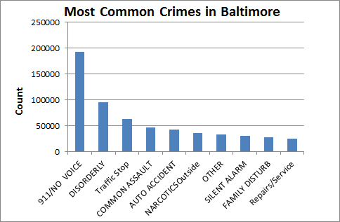
What?
What are the top 10 most common crimes? We found that 911/no voice calls happened with more frequency, although because they aren’t really a crime you could throw that data out. Besides that, the most frequent crime was disorderly conduct, followed by traffic stop incidents, common assault, and others.
1. 911/NO VOICE
2.DISORDERLY CONDUCT
3.TRAFFIC STOP
4.COMMON ASSAULT
5.AUTO ACCIDENT
6.NARCOTICS OUTSIDE
7.OTHER
8.SILENT ALARM
9.FAMILY DISTURB
10.REPAIRS/SERVICE

Slide 3
What? (Policy)
Police could increase training to handle the top ten crimes based on the data. The amount of police on the streets at night around popular areas of the city could be adjusted based on the graph .
Since there is a lot of auto accidents, the police could work with the Department of Transportation to make roads safer and study the traffic patterns. Also, increase patrols for DUI, according to the data, based on the day, time, and location.

Slide 4
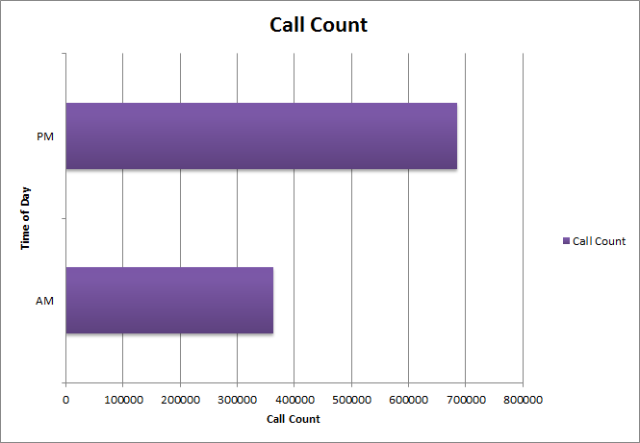
When?
What time of day do crimes tend to occur?
Unsurprisingly, we found that more calls were made at night. What was interesting, though, was the fact that nearly twice as many calls were made at night.

Slide 5
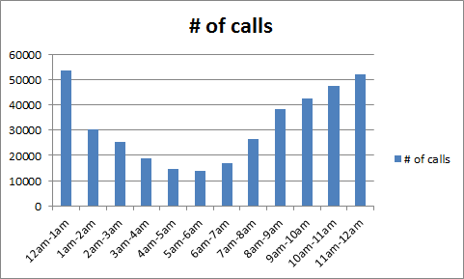
A.M. Hourly Crimes

Slide 6
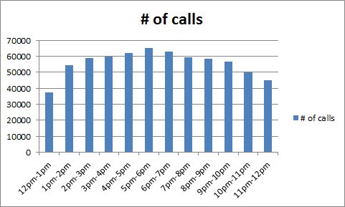
P.M. Hourly Crimes

Slide 7
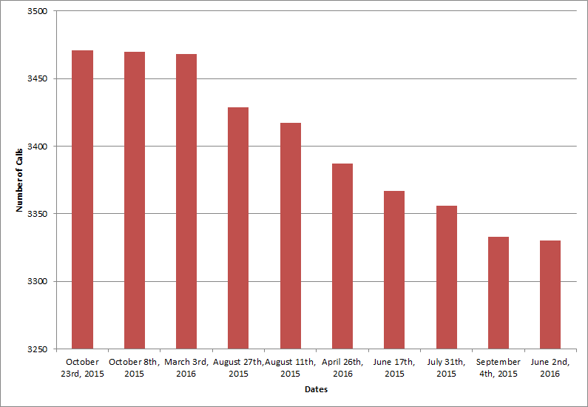
When?
What time of year has the most crimes?
We examined the ten days where the most calls were received and found that eight of those ten days fell within the second half of the year. We also found that this was a trend throughout the data.

Slide 8
When?
Disorderly Conduct
March 26 - 56
Most Happened between July-August
End of November- December picked up again
Traffic Stop
85 March 26
July - August = Most
End of November - December picked up again
Common Assault
July - August = Most
End of November - December picked up again
Auto Accident
July – August = Most
End of November- December picked up again
Narcotics Outside
July - August = Most
End of November - December picked up again
January = Slow

Slide 9
When? (Policy)
Allocate more police officers in PM hours proportionate to the average of calls made every hour.
Have more officers on duty during the summer and November to December

Slide 10
How can we prevent the amount of calls received at the peak time?
As a city, the most important factor is safety. The Baltimore Police Department can place one or two cops each shift with lesser hours at different locations. This provides a recharged brain and fresh perspective for every situation given to the on duty cops. Many studies show that being tired and having extended work hours equals a dull mind.

Slide 11
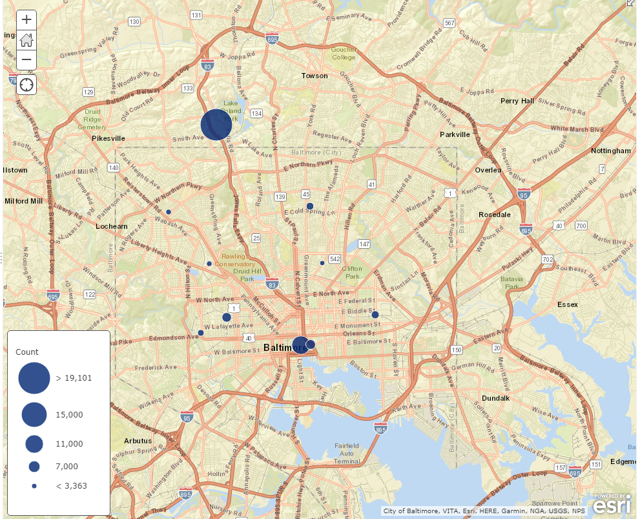
Where?
https://arcg.is/0WHOKu
The dots on the map show the top ten latitude and longitude locations that 911 calls were received from. There was an unusually high number of calls from one location in the section of northern Baltimore area. The reason for this concentration is unknown as there are no obvious things in the area that would attract crime.

Slide 12
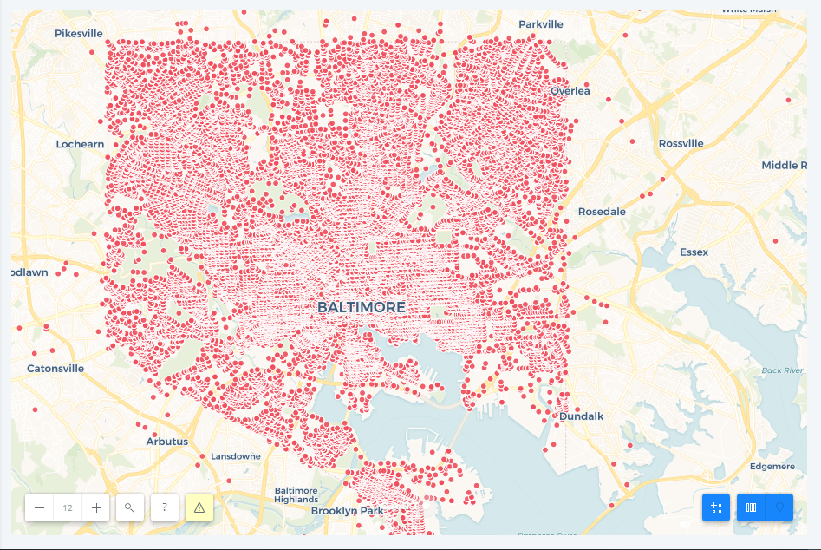
Map (All crimes)

Slide 13
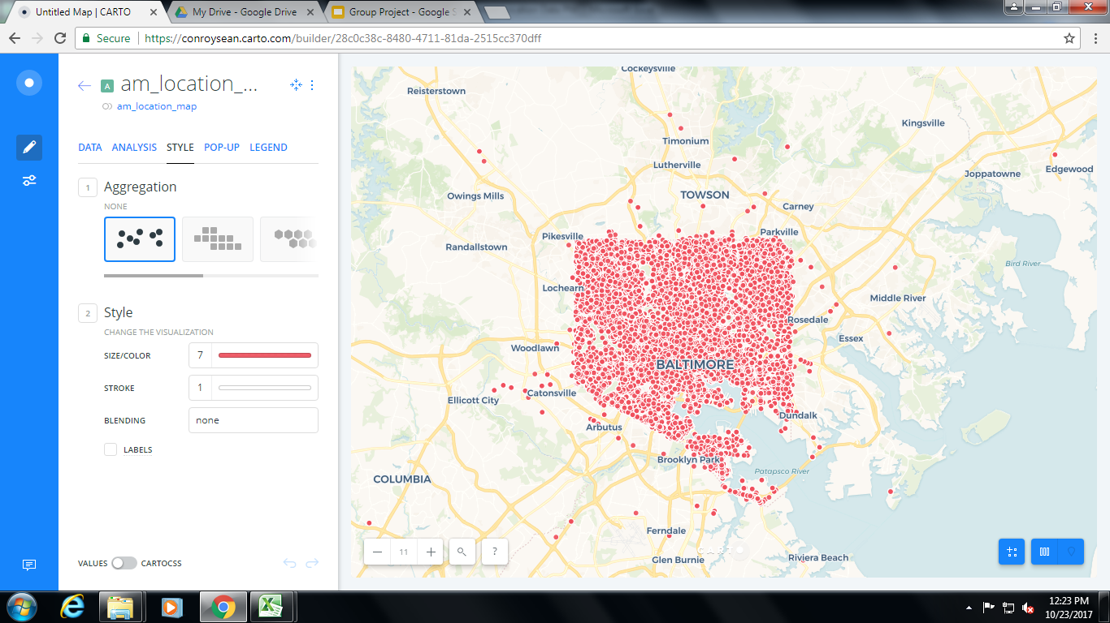
Map (A.M. Crimes)
https://conroysean.carto.com/builder/28c0c38c-8480-4711-81da-2515cc370dff/embed

Slide 14
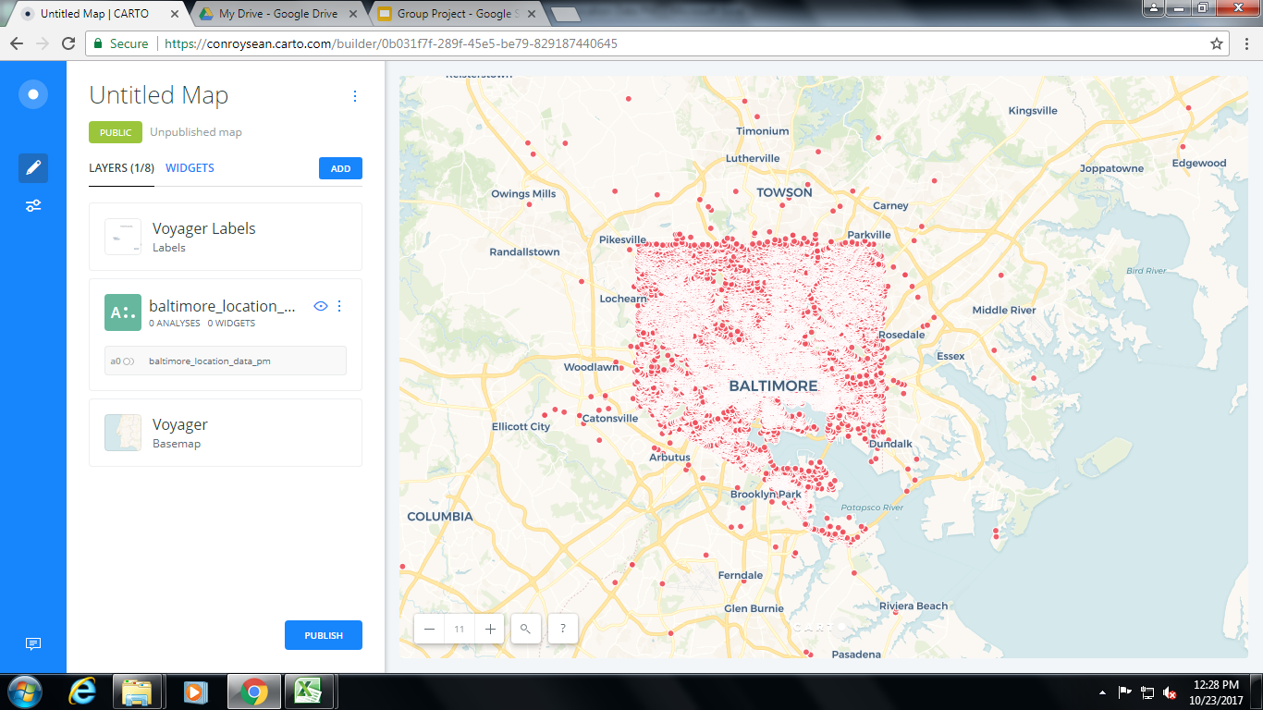
Map (P.M. Crimes)
https://conroysean.carto.com/builder/c72d2679-230d-4bab-9432-cdbf60569811/embed

Slide 15
Where?
The most calls happened in the
Northeast district in Baltimore. The calls with the average priority were the most reported.

Slide 16
Where? Policy
To greater increase safety, Baltimore police should more focus on the heart of the city (near the bay) and still enforce near the outside, but still focus more on the heart of the city.

